Slide 1
26-6-25

Slide 2
Noise
All experiments: isolated one type of noise

Slide 3
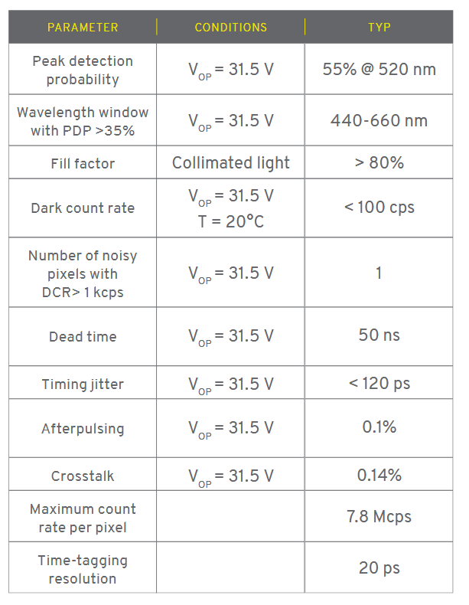
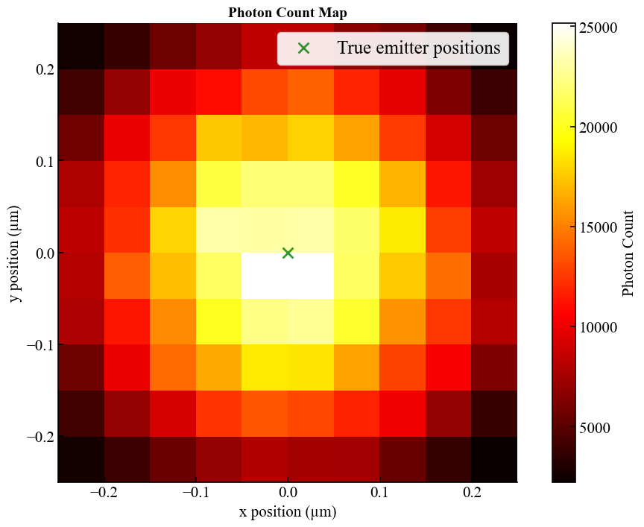
Dark counts
100 counts per second per detector pixel
For 0.1 ms dwell time (1e5 ns):
0.01 count per scan position.
At 200kW/cm^2, we get on average per scan position 12000 detected photons (no noise, detection prob. =1, avg over 100 scanning positions of 1 emitter). So impact is very limited.
Notes:
12000 detected photons is the sum over all 23 pixels of the SPAD.

Slide 4
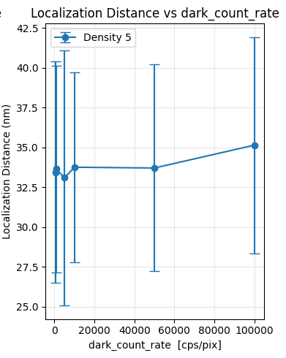
Dark counts

Slide 5
Dead Time

Slide 6
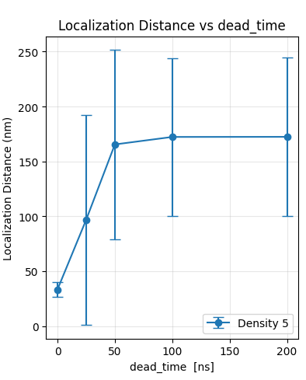
Dead Time
Reduces amount of detected photons
At 200kW/cm^2 intensity and 50ns dead time, we need more measurement time than 0.1 ms per scanning position. (4x as much for same performance)

Slide 7
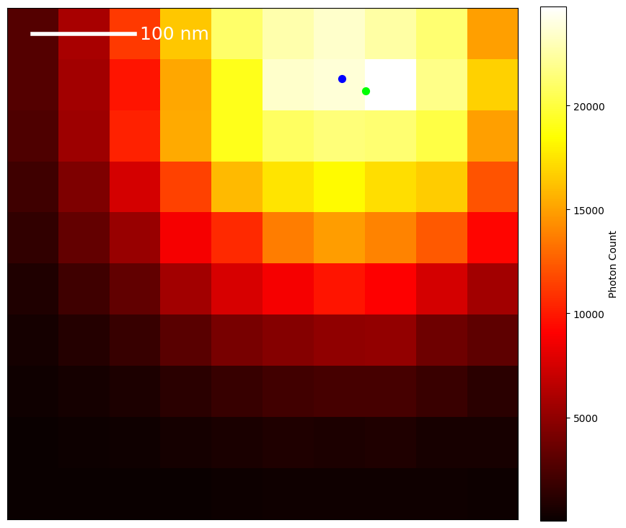
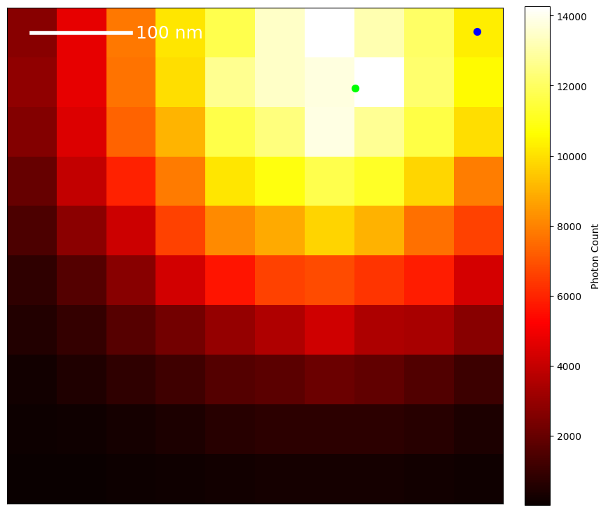
Intensity reduction by ~40% at 50ns deadtime

Slide 8
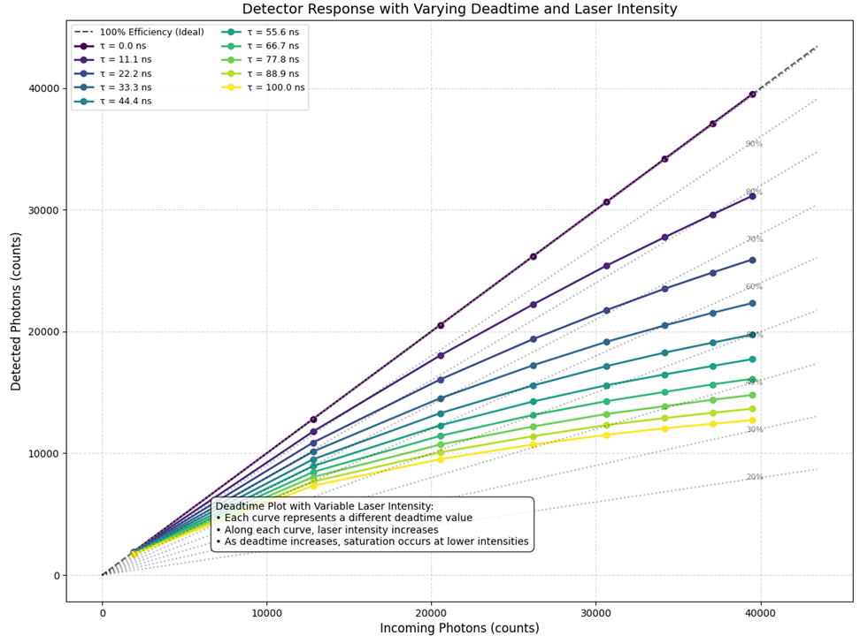
At 50 ns deadtime 0.1 ms dwell time, detection plateaus at ≈19000 detections.
Notes:
Why is it not equal to 100000 ns / 50 ns = 2000 ns * 23 pixels = 46000 photons? Because the detections are not equally spread over the pixels, but concentrated at the center pixel.

Slide 9
Afterpulsing
0.1% chance of a detection giving rise to another detection. This can also happen for dark counts

Slide 10
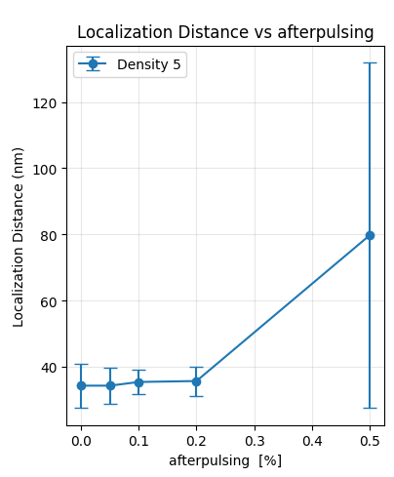
Afterpulsing
Breaks down for 0.5% afterpulsing

Slide 11
Crosstalk
0.14% chance of neighbouring pixel activated
if the selected neighbor pixel is not available, then choose another or just let it be?
edge pixels have less neighbors. Because of that, the same neighbors will be selected more often than for center pixels.
should the crosstalk timestamp contain jitter?

Slide 12
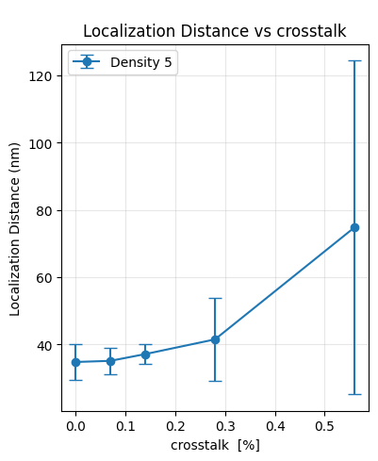
Crosstalk
Starts decreasing fast above 0.3% crosstalk

Slide 13
Now: combining all noise sources!
Dead time: 50 ns
Dark count rate: 100cps
Crosstalk: 0.14% chance
Afterpulsing: 0.1% chance
How long a dwell time is needed?

Slide 14
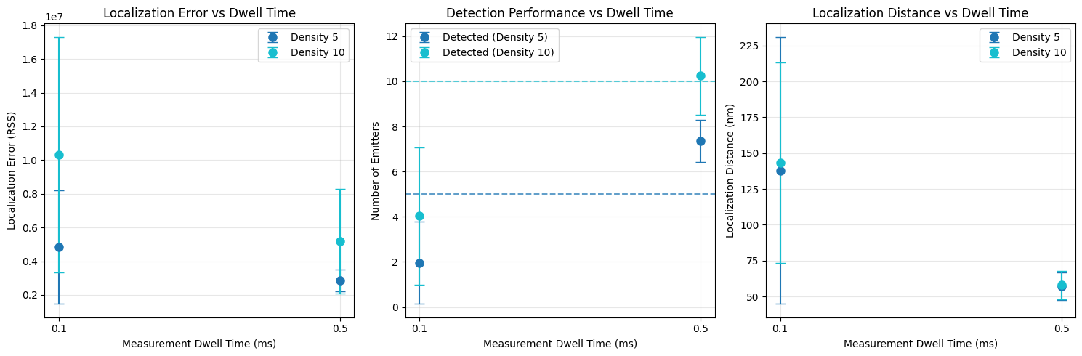
Combined noise
Dwell time: 0.1ms (standard so far) vs 0.5 ms (5x time per pos.)
Localization distance tripled w.r.t. no noise for 0.1ms
Large improvement for longer dwell time

Slide 15
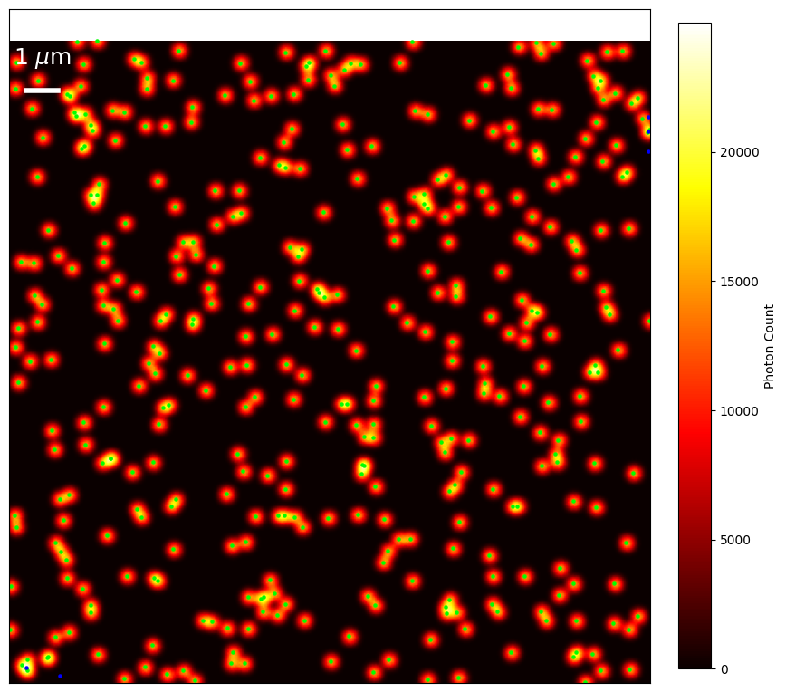
20x20 micrometer
400x400 positions (50nm steps)
1 emitter / um^2
Noise included
Fitting failed likely due to regularization on emitter count still being on (here: 400 emitters, while on 1x1 um we have 1-10 emitters) so need to run it again

